Slide 1

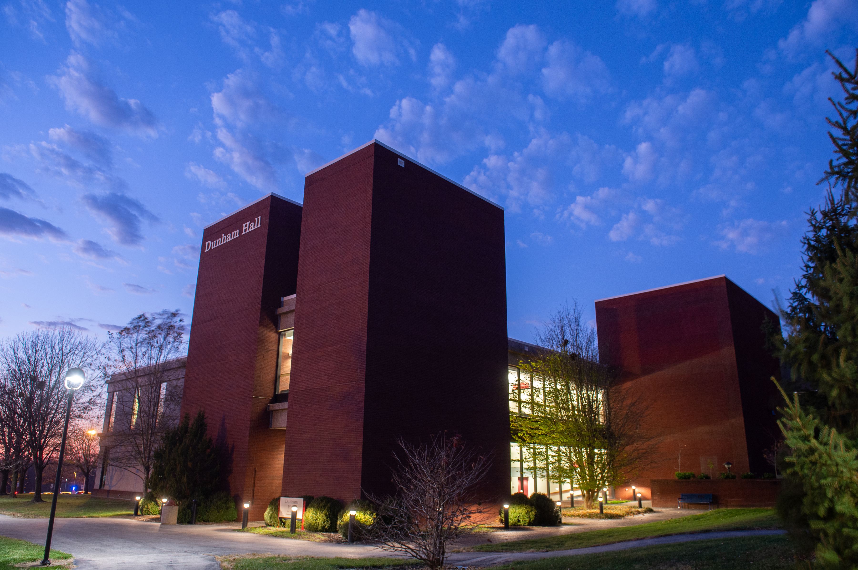
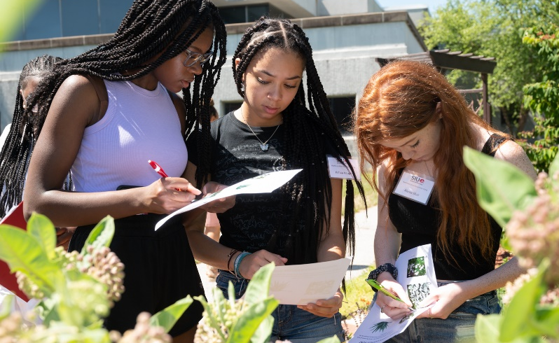
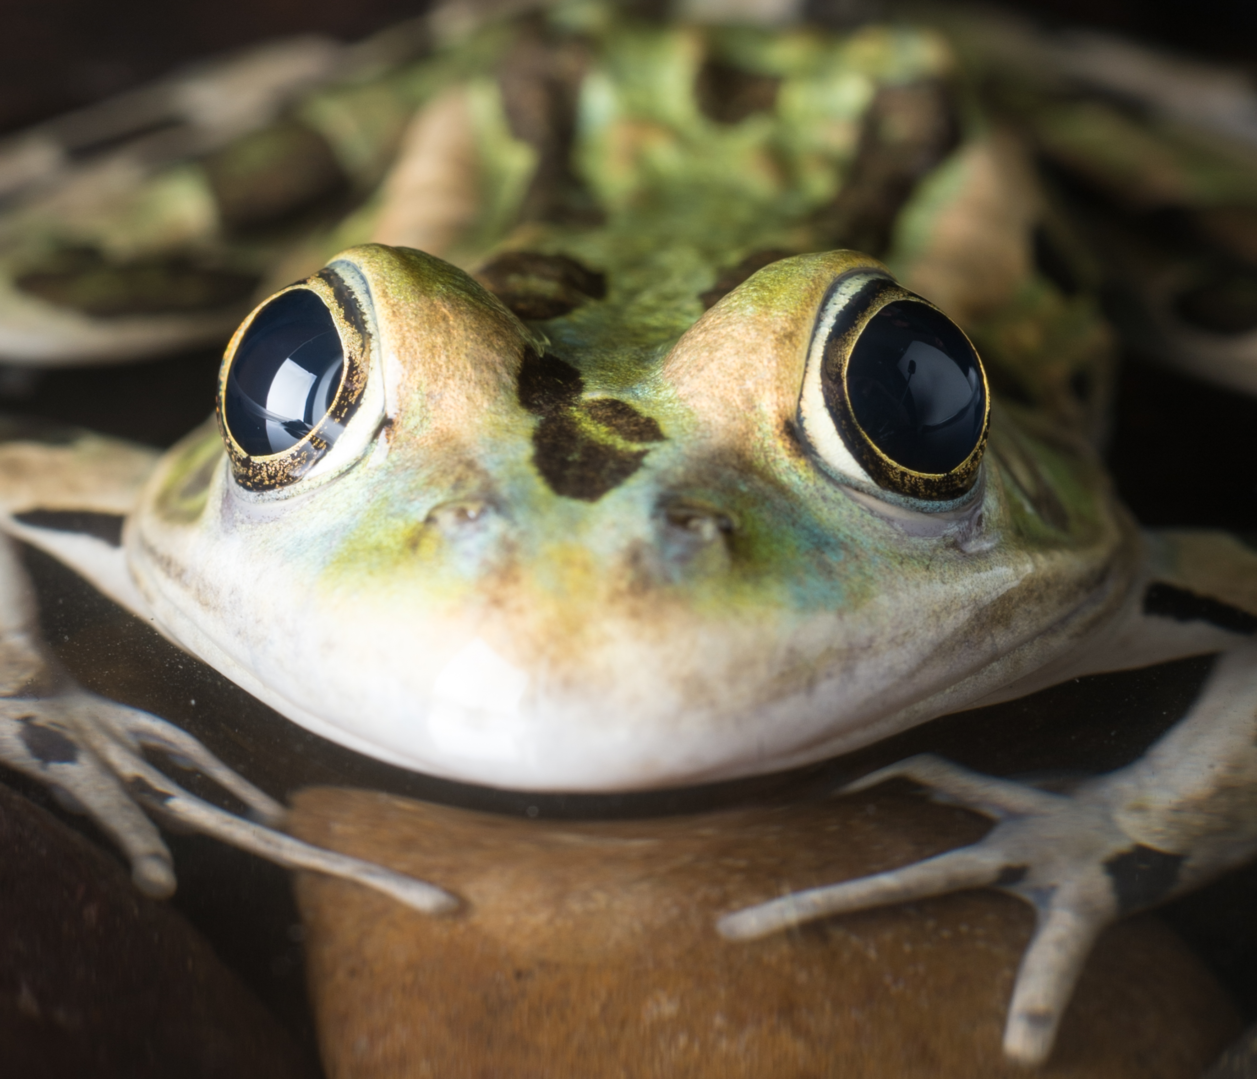

Slide 2
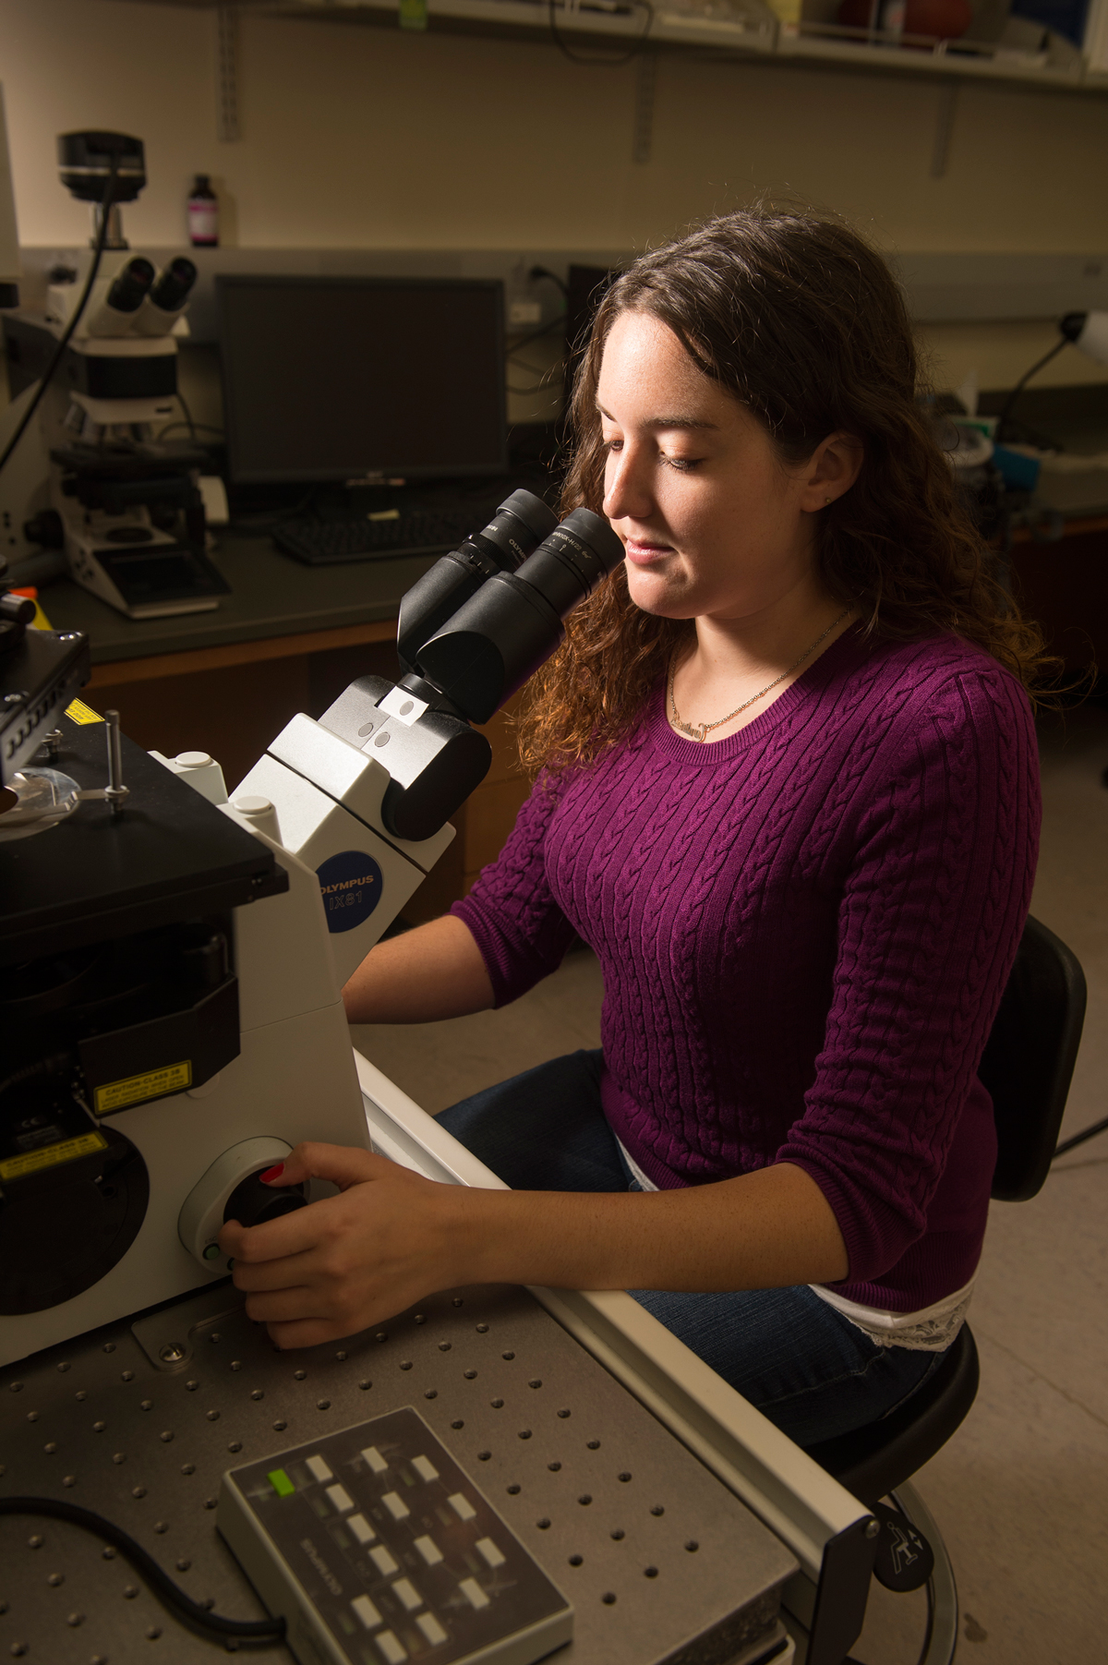
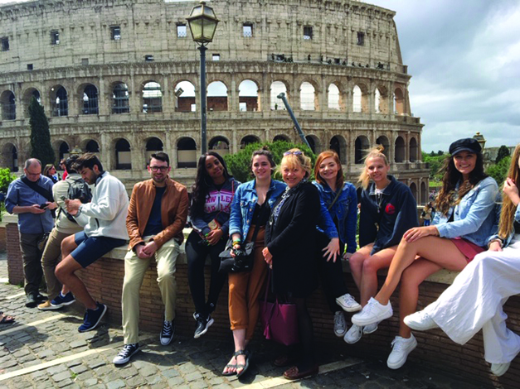
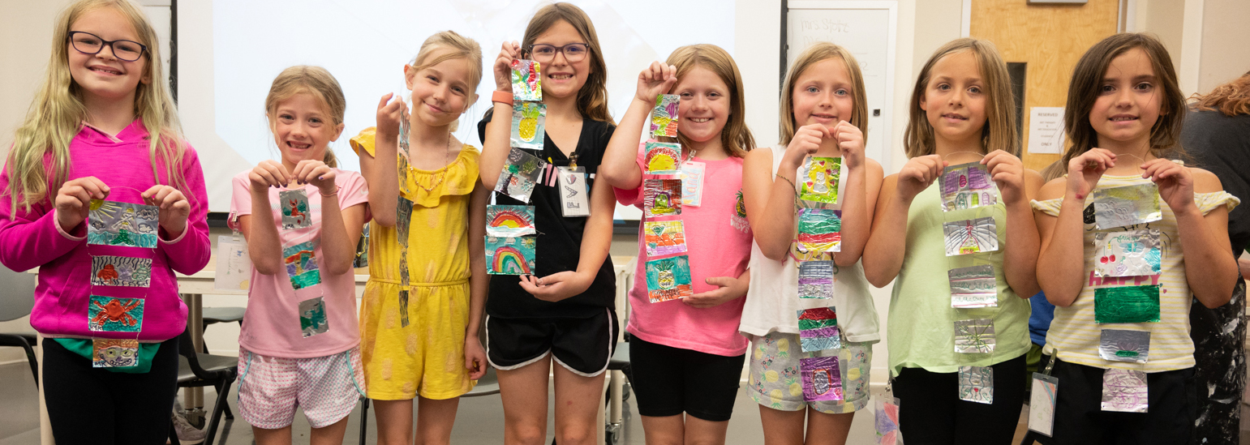

Slide 3
Text

Slide 4
Text
Text

Slide 5
Text
Text
Text

Slide 6
Text
Text

Slide 7
Text

Slide 8
Text

Slide 9
Text
Text

Slide 10
Text
Text
Text

Slide 11
Text
Text
Text
Text

Slide 12
Text
Callout Text
Text

Slide 13
Text
Text

Slide 14
Text
Text

Slide 15
Title Slide

