Slide 1

Accommodate for Faculty:
Accessible Campus Community & Equitable Student Support

Slide 2
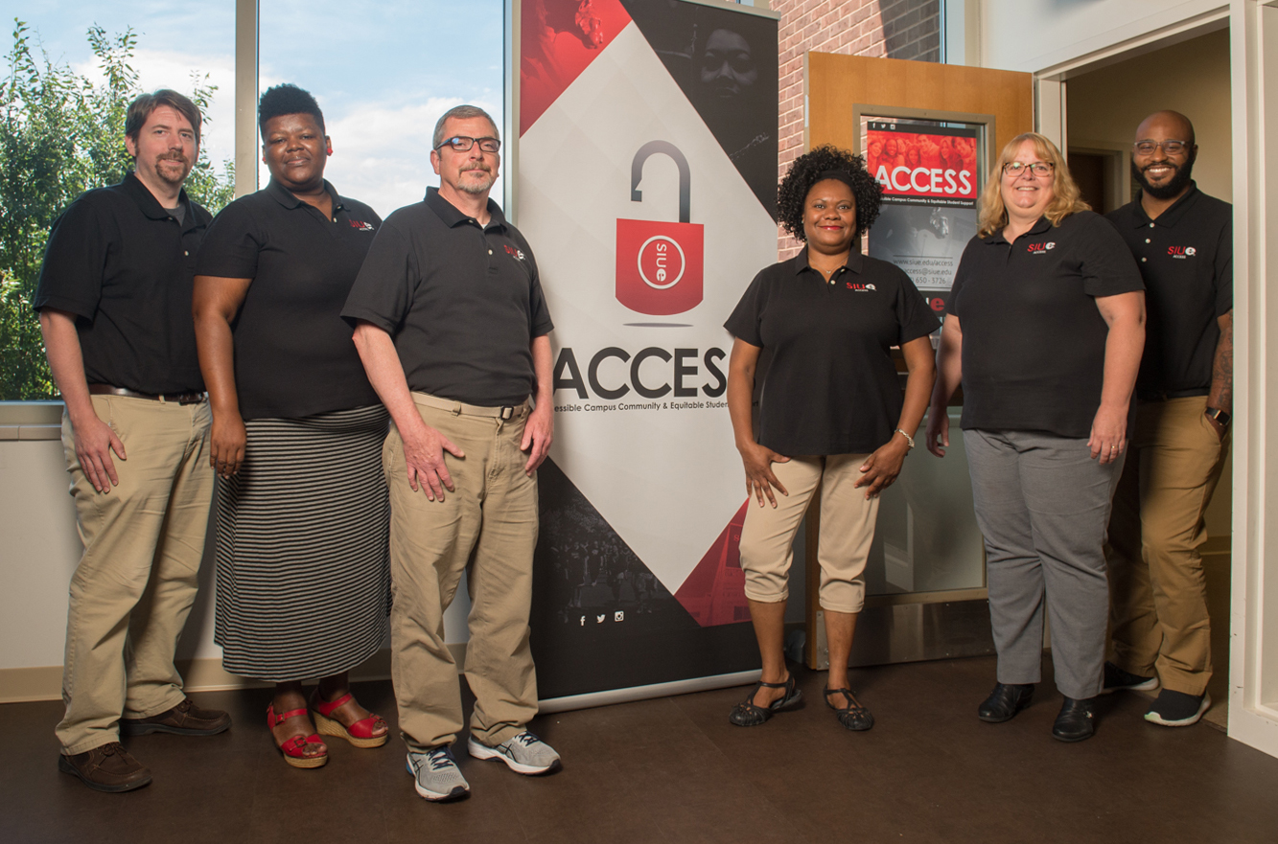
Accessible Campus Community & Equitable Student Support (Access)
We approve reasonable accommodations which address barriers to student inclusion or accurate assessment of academic aptitude (i.e. time-limited exams, inaccessible web content, or the use of non-captioned videos.)
Students needing accommodations because of medical diagnoses or major life impairment(s) will need to register with ACCESS and complete an intake process before accommodations will be approved. Students who believe they have a diagnosis but do not have documentation should contact ACCESS for assistance and/or appropriate referral.

Slide 3
Resources/Accommodations
Priority Registration
Email to Faculty/Advocacy
Testing Accommodations (Extended Time [1.5x or 2x], Computer, Segregated Testing, Scribe, Reader, Scantron Assistance, CCTV)
Intermittent/Extended Absences
Volunteer Note Takers
Self-Recorded Lecture
Textbooks in Alternative Format (MP3, Variable-Size Font, PDF, Kindle, Other)
Deaf and Hard of Hearing Services (ASL Interpreter, RTC, Captioned Video, Assistive Listening Device)
Classroom (Priority Seating, Accessible Table, Accessible Chair)
Service Animal
Emotional Support Animal
Housing Accommodations
Other

Slide 4
What ACCESS Wants you to know!
Our new system (Accommodate) will allow for increased transparency and communication in facilitating approved student accommodations.
  Check out the Faculty Portal today by visiting siue.edu/access/faculty and clicking the grey banner at the bottom of the page which reads “Login Portal”!
  Now you can see approved accommodations for students enrolled in your class!
ACCESS now has evening hours to accommodate testing accommodations beyond 4:30 pm.
  Students are expected to take their tests the same day/time as the rest of the class unless there are extenuating circumstances.
Our clients aren’t just students; they’re faculty as well!
  We don’t approve accommodations to fundamentally alter the curriculum. If you have questions about how an approved accommodation will impact your class, call us!

Slide 5
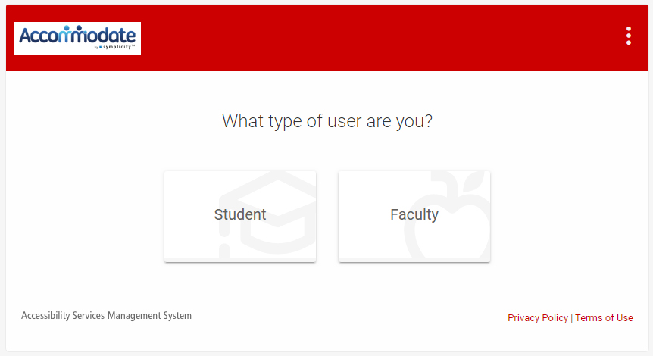
Welcome to Accommodate
As part of our new process, accommodations notifications will all be facilitated from SIUE Accommodate.
Once you arrive, click on the icon labeled “Faculty" and enter your e-ID and password just as you would for your email, Blackboard, or CougarNet access.

Slide 6
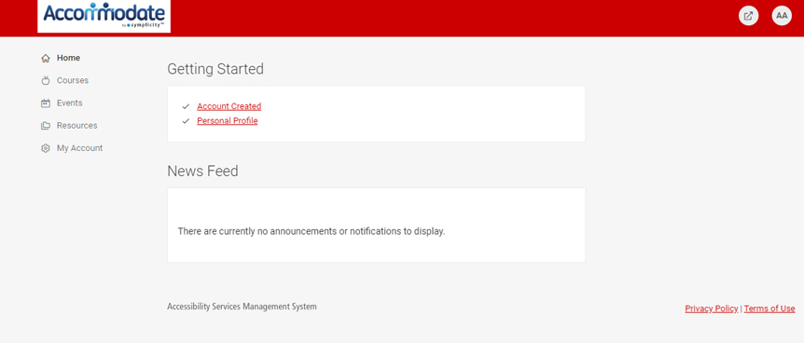
Welcome to Accommodate (cont.)
Once you've successfully logged in, you will see several tabs to the left of the screen for: Home, Courses, Events, Resources and My Account

Slide 7
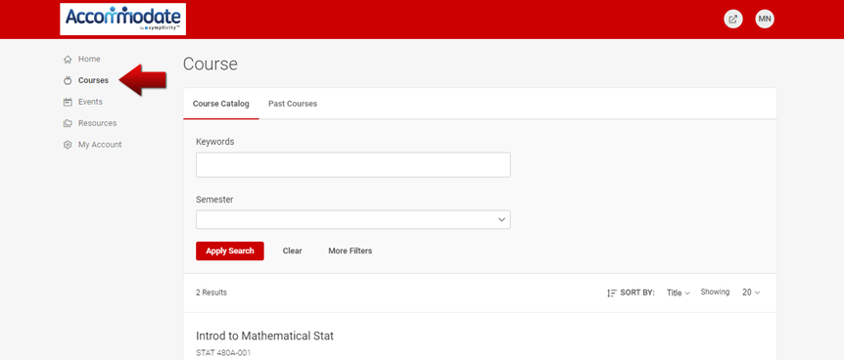
Reviewing Student Accommodations
Thanks to the Accommodate platform you are able to review approved accommodations for enrolled students at any time.
By clicking on the “Courses” tab, you can see every class currently or previously taught by you.

Slide 8
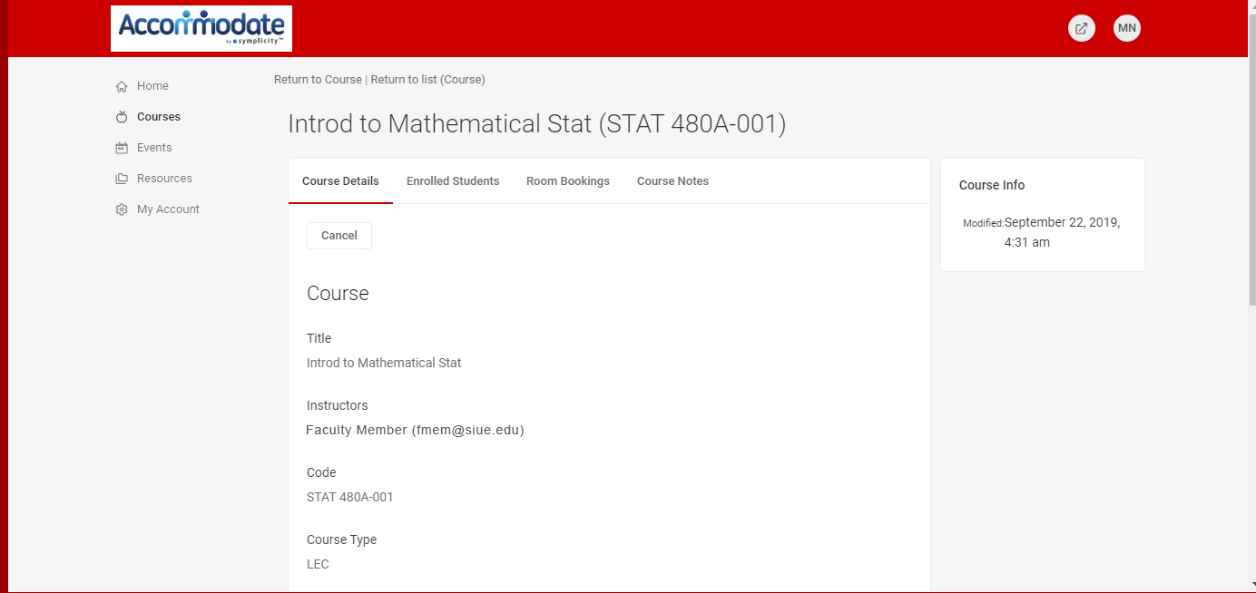
Reviewing Student Accommodations (course details)
By clicking on the name of the course, you can see the course details, as well as tab headings for: Enrolled Students, Room Bookings and Course Notes.

Slide 9
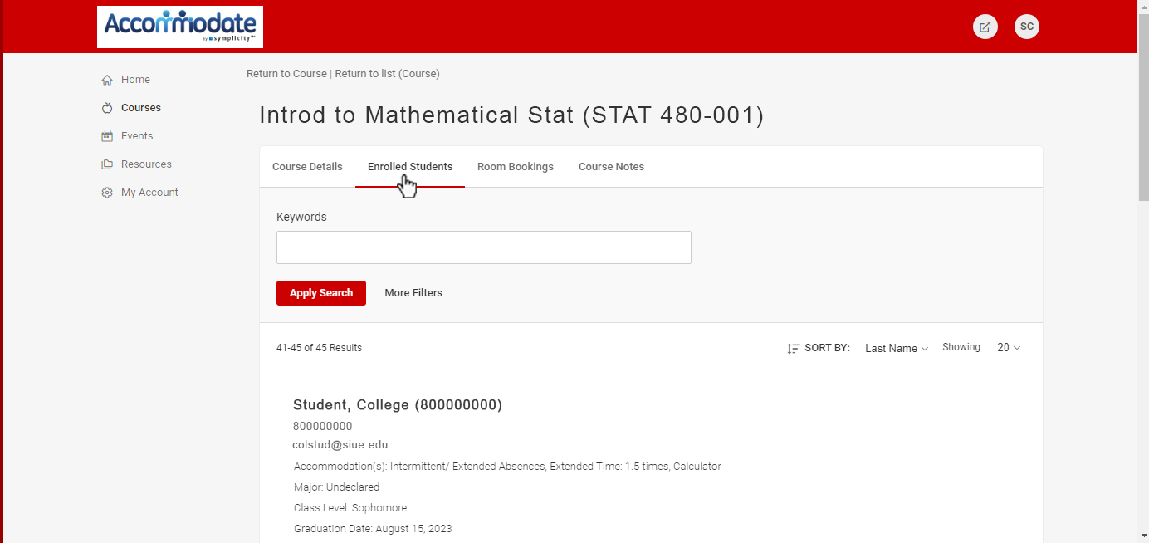
Reviewing Student Accommodations (cont.)
By clicking “Enrolled Students” you will see all students currently enrolled as well as their class level, student ID and approved accommodations should they be registered with our office.
Under “Note Taker” you will see a red ‘x’. If that particular student has agreed to be a note taker, the red x will be replaced by a green check mark.

Slide 10
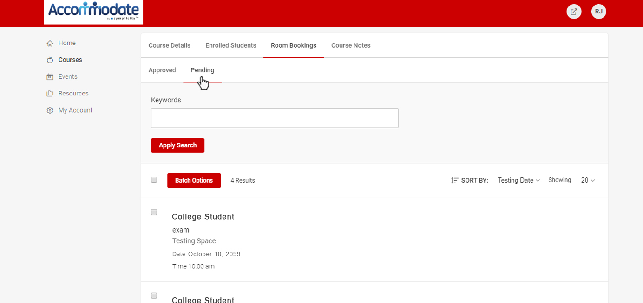
Reviewing Student Accommodations (room bookings)
By clicking on the “Room Bookings” tab, you can see all approved and pending testing accommodation requests.
These requests are organized by student and show the location for the exam, the date requested as well as the scheduled time.

Slide 11
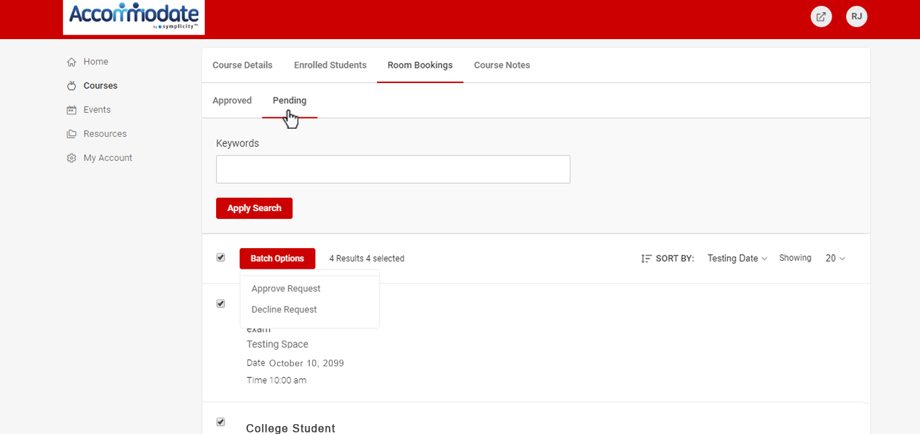
Reviewing Student Accommodations (pending requests)
Next to each students’ name on each row is a small check box. This allows for a “batch option” or set of options to be executed.
As a result, you can approve or decline multiple requests at once for a particular student who has scheduled multiple exams.

Slide 12
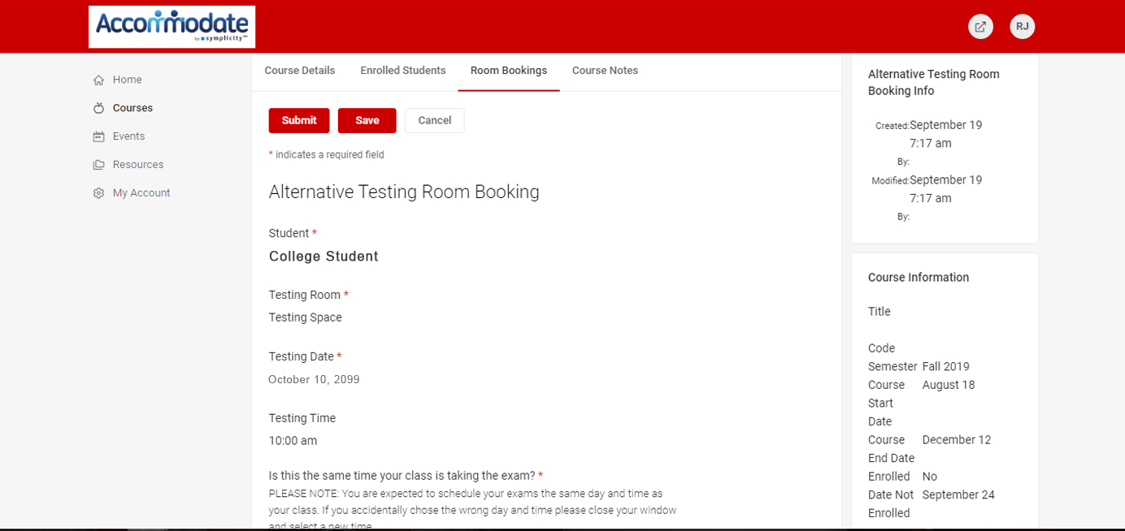
Testing Accommodations
By clicking on the student’s name, you will see all the relevant information regarding the student’s request.
On the “Alternative Testing Room Booking” page, you will see the name of the student, the location, the date of the exam as well as the time.

Slide 13
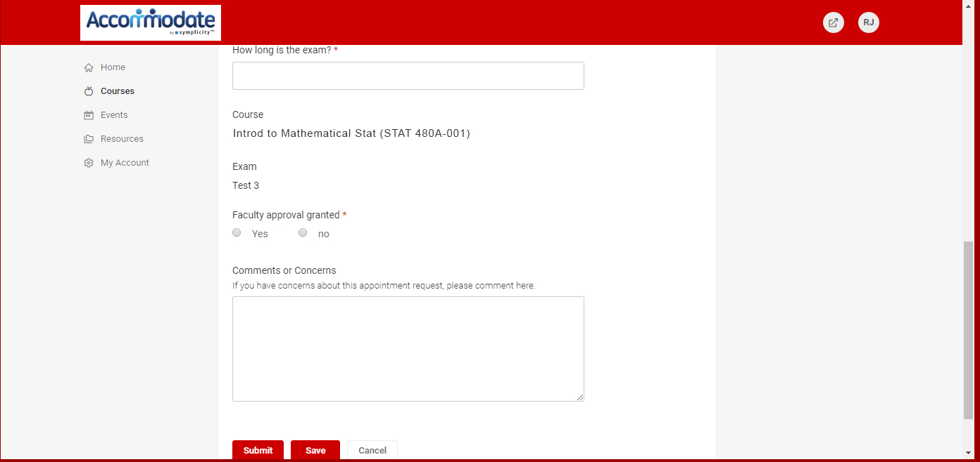
Testing Accommodations (cont.)
This is the page you will be able to approve and respond to prompts regarding the exam to be proctored by ACCESS.
Here you will be able to adjust information regarding the length of the exam, contact number as well as location for the exam to be delivered.

Slide 14
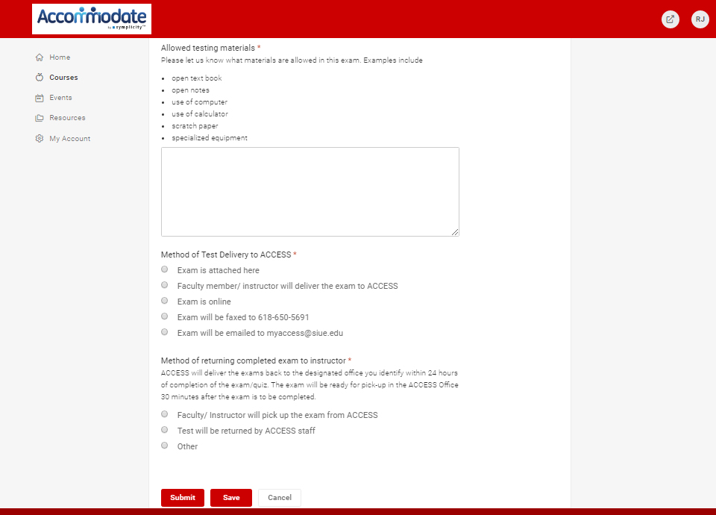
Approving Testing Accommodations
Once you click the “approved” radio button, additional options will be made available to allow you to enter special instructions regarding allowed testing materials as well as:
  Method of Test Delivery (you may upload your exam electronically here, fax or hand deliver the exam)
  Method of return (i.e. pick up or returned to faculty)
Lastly, before you approve the request please add any additional instructions in the comments before clicking “submit”.

Slide 15
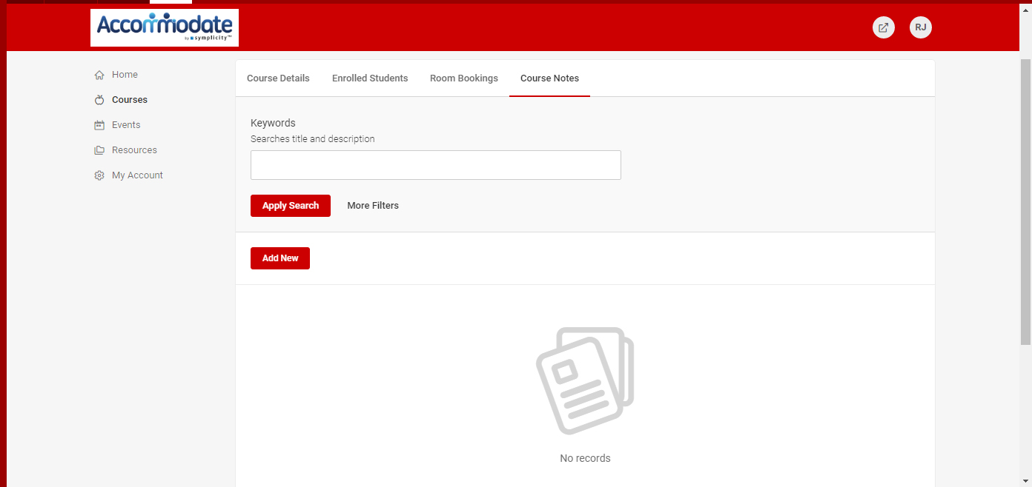
Course Notes & Events
In addition to the Room Bookings/Testing Accommodation functions of accommodate, there is a tab to allow you to upload course notes should you choose to do so.
There is also an “Events” tab which features all workshops or events made available to the Campus Community through ACCESS.
Please be on the look out for upcoming opportunities for workshops and trainings to be offered through the office on Accessibility Advocacy as well as cohort events for the BUILD Mentoring Program.

Slide 16

Still have questions?
If you have any more questions, or concerns about how to use the accommodate system, feel free to contact us directly at myaccess@siue.edu or by phone at 618.650.3726

